Slide 1
Lecture II
Monte Carlo Sampling

Slide 2
1.
Random Walks
Probabilistic equilibrium
Detailed balance
Metropolis rule

Slide 3
Derivation of random walk concept and detailed balance

Slide 4
M
+
+
high
+
+
+
+
+
+
+
+
+
+
+
+
+
+
+
+
+
+
+
+
+
+
+
+
+
+
+
+
+
+
probability density q(m)
+
+
+
+
+
+
+
+
+
+
+
+
+
+
+
+
+
+
+
m ^{j}
+
+
+
+
+
+
+
+
+
+
T ^{i← j}
+
+
low
+
m ^{i}

Slide 5
2.
Selected Algorithms
Metropolis-Hasting algorithm
MALA
Hamiltonian Monte Carlo
Effective sample size

Slide 6
The local Metropolis-Hastings algorithm

Slide 7
The local Metropolis-Hastings algorithm
distribution we wish to sample
m₀

Slide 8
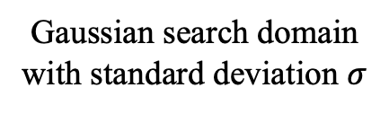

The local Metropolis-Hastings algorithm
Gaussian search domain with standard deviation $σ$
$$σ$$
m₀

Slide 9

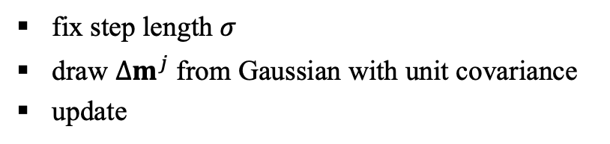
The local Metropolis-Hastings algorithm
Metropolis-Hastings model update
fix step length $σ$
draw $Δm^{j}$ from Gaussian with unit covariance
update
move to m₁ in accord with Metropolis rule
m₁
m₀

Slide 10
The local Metropolis-Hastings algorithm
m₁
m₂
m₀

Slide 11
The local Metropolis-Hastings algorithm
m₃
m₂

Slide 12


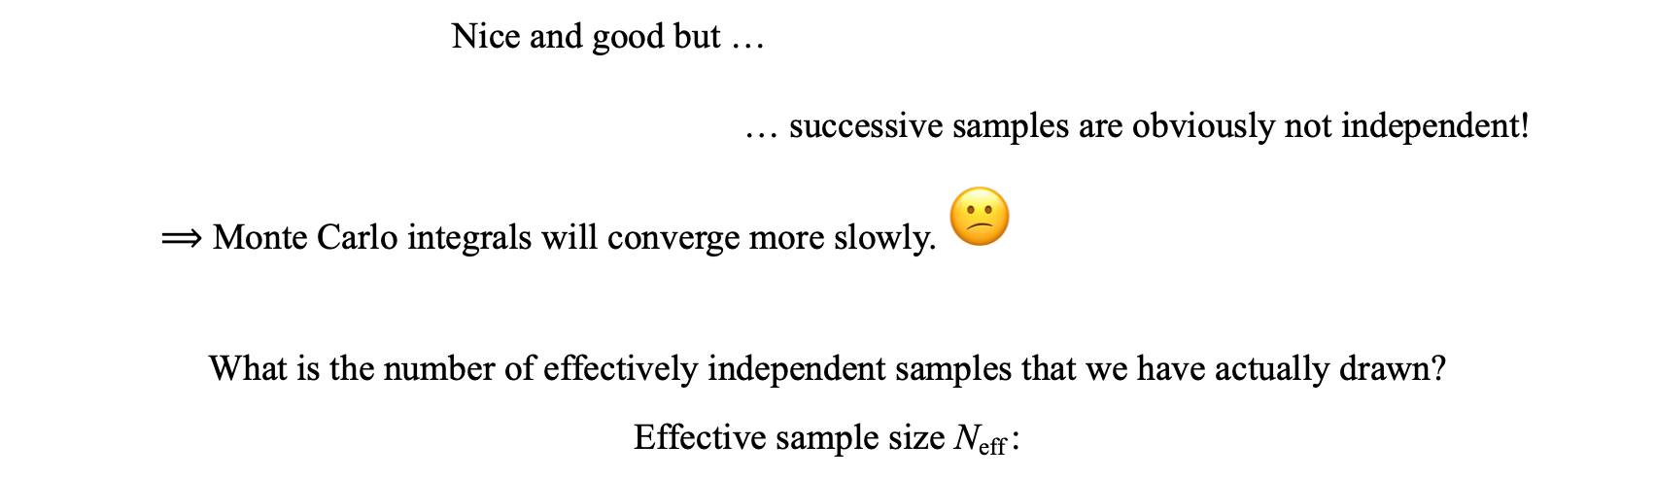
Effective sample size
Nice and good but …
… successive samples are obviously not independent!
$⟹$ Monte Carlo integrals will converge more slowly. 😕
What is the number of effectively independent samples that we have actually drawn?
Effective sample size N_{eff} :
auto-correlation of the sample chain
measure of how independent successive samples are
effective sample size
anti-proportional to area under the auto-correlation plot

Slide 13
Effective sample size
Nice and good but …
… successive samples are obviously not independent!
$⟹$ Monte Carlo integrals will converge more slowly. 😕
What is the number of effectively independent samples that we have actually drawn?
Effective sample size N_{eff} :
auto-correlation of the sample chain
measure of how independent successive samples are
effective sample size
anti-proportional to area under the auto-correlation plot

Slide 14
Effective sample size
Nice and good but …
… successive samples are obviously not independent!
$⟹$ Monte Carlo integrals will converge more slowly. 😕
What is the number of effectively independent samples that we have actually drawn?
Effective sample size N_{eff} :
auto-correlation of the sample chain
measure of how independent successive samples are
effective sample size
anti-proportional to area under the auto-correlation plot

Slide 15
Effective sample size
Nice and good but …
… successive samples are obviously not independent!
$⟹$ Monte Carlo integrals will converge more slowly. 😕
What is the number of effectively independent samples that we have actually drawn?
Effective sample size N_{eff} :
auto-correlation of the sample chain
measure of how independent successive samples are

Slide 16
Effective sample size
Nice and good but …
… successive samples are obviously not independent!
$⟹$ Monte Carlo integrals will converge more slowly. 😕
What is the number of effectively independent samples that we have actually drawn?
Effective sample size N_{eff} :
auto-correlation of the sample chain
measure of how independent successive samples are
effective sample size
anti-proportional to area under the auto-correlation plot

Slide 17
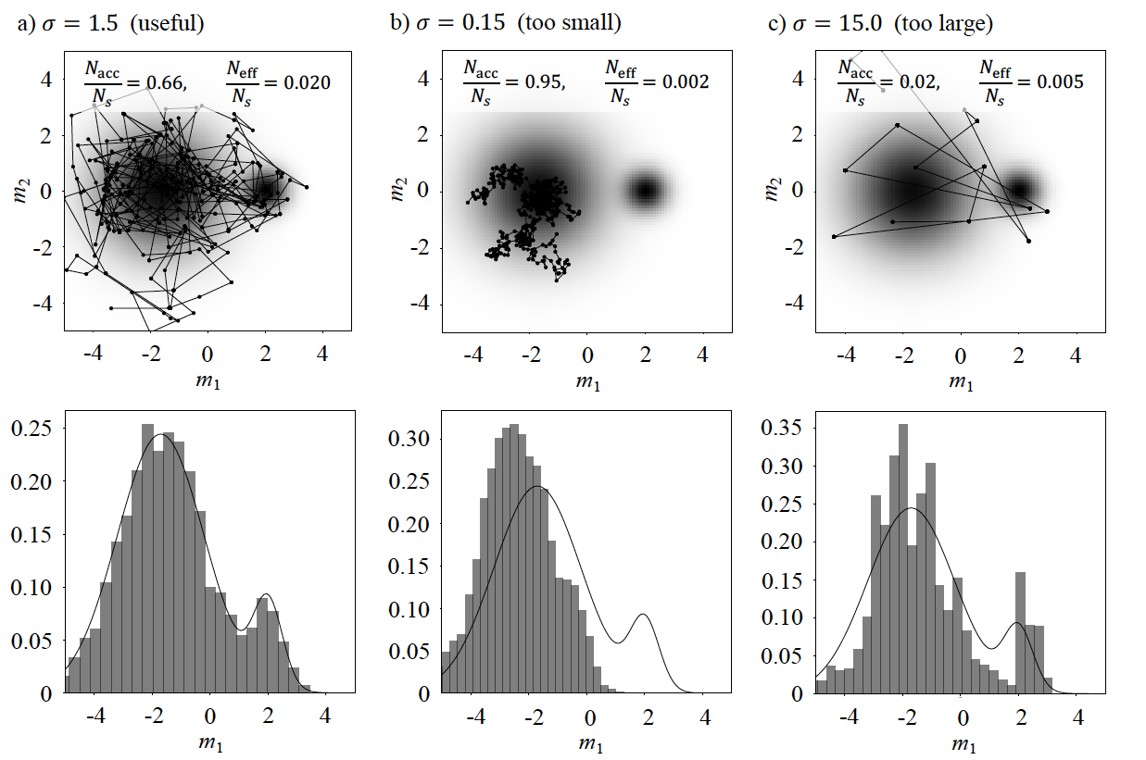
An example
acceptance
rate
effective sample size

Slide 18
An example

Slide 19
An example

Slide 20
MALA – Metropolis-adjusted Langevin algorithm

Slide 21
MALA – Metropolis-adjusted Langevin algorithm
Metropolis-Hastings update:

Slide 22

MALA – Metropolis-adjusted Langevin algorithm
Metropolis-Hastings update:
MALA update:
gradient of the log distribution
points in direction of steepest ascent

Slide 23
MALA – Metropolis-adjusted Langevin algorithm
Metropolis-Hastings update:
MALA update:
gradient of the log distribution
points in direction of steepest ascent
m₁
m₀

Slide 24
MALA – Metropolis-adjusted Langevin algorithm
Metropolis-Hastings update:
MALA update:
gradient of the log distribution
points in direction of steepest ascent
m₂
m₁
m₀

Slide 25
MALA – Metropolis-adjusted Langevin algorithm
Metropolis-Hastings update:
MALA update:
gradient of the log distribution
points in direction of steepest ascent
m₂
m₁
m₃
m₀

Slide 26
MALA – Metropolis-adjusted Langevin algorithm
Metropolis-Hastings update:
MALA update:
gradient of the log distribution
points in direction of steepest ascent
m₂
m₁
m₄
m₃
m₀

Slide 27
MALA – Metropolis-adjusted Langevin algorithm
Metropolis-Hastings update:
MALA update:
gradient of the log distribution
points in direction of steepest ascent
m₂
m₁
m₄
m₃
m₀
MALA can rapidly approach the typical set.
It is a hybrid between Metropolis-Hastings and the method of steepest descent.

Slide 28
Hamiltonian Monte Carlo

Slide 29
Hamiltonian Monte Carlo
initial model
treated as particle in n-dimensional space
equipped with artificial mass matrix M
maximum-likelihood model

Slide 30

Hamiltonian Monte Carlo
Initial model m, chosen randomly.
Misfit U(m) defines potential energy.
initial model
e.g.:
$$U\left(m\right)=−\log{ρ(m|d^{obs})}$$
maximum-likelihood model

Slide 31
Hamiltonian Monte Carlo
Initial model m, chosen randomly.
Misfit U(m) defines potential energy.
Random momentum p [auxiliary quantity].
Defines kinetic energy K(p).
p
maximum-likelihood model

Slide 32
Hamiltonian Monte Carlo
Initial model m, chosen randomly.
Misfit U(m) defines potential energy.
Random momentum p [auxiliary quantity].
Defines kinetic energy K(p).
Solve Hamilton’s equations with Hamiltonian
H(m,p) = U(m) + K(p) .
Move towards a new test model, m_{test}.
p
m_{test}

Slide 33
Hamiltonian Monte Carlo
Initial model m, chosen randomly.
Misfit U(m) defines potential energy.
Random momentum p [auxiliary quantity].
Defines kinetic energy K(p).
Solve Hamilton’s equations with Hamiltonian
H(m,p) = U(m) + K(p) .
Move towards a new test model, m_{test}.
Evaluate Metropolis rule:
If rejected: go back.
If accepted: move on.
p

Slide 34
Hamiltonian Monte Carlo
Initial model m, chosen randomly.
Misfit U(m) defines potential energy.
Random momentum p [auxiliary quantity].
Defines kinetic energy K(p).
Solve Hamilton’s equations with Hamiltonian
H(m,p) = U(m) + K(p) .
Move towards a new test model, m_{test}.
Evaluate Metropolis rule:
If rejected: go back.
If accepted: move on.

Slide 35
Hamiltonian Monte Carlo
Initial model m, chosen randomly.
Misfit U(m) defines potential energy.
Random momentum p [auxiliary quantity].
Defines kinetic energy K(p).
Solve Hamilton’s equations with Hamiltonian
H(m,p) = U(m) + K(p) .
Move towards a new test model, m_{test}.
Evaluate Metropolis rule:
If rejected: go back.
If accepted: move on.

Slide 36
Hamiltonian Monte Carlo
Key features
Pros:
Acceptance of long-distance moves.
Fast model space exploration.
Cost of generating independent model ∝ n^{1.2} [compared to n² for Metropolis-Hastings].
Can be tuned for high efficiency [n(n+1)/2 elements of the mass matrix M]
Cons:
Requires derivatives of the forward problem [compensated for high dimensions].
Must be tuned to avoid inefficiency.

Slide 37
Hamiltonian Monte Carlo
Key features
Pros:
Acceptance of long-distance moves.
Fast model space exploration.
Cost of generating independent model ∝ n^{1.2} [compared to n² for Metropolis-Hastings].
Can be tuned for high efficiency [n(n+1)/2 elements of the mass matrix M]
Cons:
Requires derivatives of the forward problem [compensated for high dimensions].
Must be tuned to avoid inefficiency.

Slide 38
3.
The Algorithmic Spectrum

Slide 39

Metropolis-Hastings
MALA
Hamiltonian Monte Carlo
algorithmic complexity
low
use of information
only pdf values
tuning opportunities
few
number of samples needed to produce an independent one
$$∝N^{2}$$

Slide 40


Metropolis-Hastings
MALA
Hamiltonian Monte Carlo
algorithmic complexity
low
medium
use of information
only pdf values
exploits gradients
tuning opportunities
few
few
number of samples needed to produce an independent one
$$∝N^{2}$$
$$∝N^{1.33}$$

Slide 41


Metropolis-Hastings
MALA
Hamiltonian Monte Carlo
algorithmic complexity
low
medium
high
use of information
only pdf values
exploits gradients
exploits gradients
tuning opportunities
few
few
very many
number of samples needed to produce an independent one
$$∝N^{2}$$
$$∝N^{1.33}$$
$$∝N^{1.25}$$

Slide 42
Metropolis-Hastings
MALA
Hamiltonian Monte Carlo
algorithmic complexity
low
medium
high
use of information
only pdf values
exploits gradients
exploits gradients
tuning opportunities
few
few
very many
number of samples needed to produce an independent one
$$∝N^{2}$$
$$∝N^{1.33}$$
$$∝N^{1.25}$$
tunability & problem adaptation + use of more information → efficiency & scaling

